Slide 1
Aggregates, Summary Tables and Cubes

Slide 2
Once the base Star Schema has been populated, the implementation of the Data Warehouse doesn’t stop there.
Data Warehouse’s have a presentation layer (or BI layer) that uses further data structures built from the underlying schema. These data structures provide:
Significant performance improvements for both adhoc and regular queries.
Enhanced query features - drill down, rollup, slice and dice.
Data segmentation for different parts of the business.
The data structures that enable these features are Aggregates, OLAP Cubes and Summary Tables.
Different BI engines will use slightly different terminology for these data structures but, in essence, their features are similar.
Overview

Slide 3
When dealing with millions of rows querying the data can be time-consuming and inefficient.
Data recipients are often uninterested in high levels of detail.
They may only be interested in sales by week rather than sales by day.
Multiple fact tables summarised at different levels of granularity are quite common.
They behave as database indexes and help speed up queries which require only the summarised data.
The presentation layer of the data warehouse uses these aggregate tables when generating the results of queries, they are not available to the business users.
Aggregates

Slide 4
During the analysis phase of a data warehouse project, the data analyst would review the reporting requirements to decide which aggregates would need to be created.
Each aggregate is stored as a summarised fact table linked to one or more summarised dimensions.
The summarised fact and dimension tables are derived copies of the underlying base fact and dimension tables.
Known as derivative tables.
The base schema and the new summarised tables co-exist. The summarised tables are created from the underlying base schema once the base schema tables have been populated / refreshed.
Let’s look at an example…
Creating Aggregates

Slide 5
Total Revenue and Total Units Sold
by Product Category, Customer, Geography and Day
Aggregate Example
Here we have a requirement for a one-way aggregate. The report needs the detail down to the lowest level for customer, geography and date but happy to aggregate on product category only (hence one-way).
What’s required is a derived (aggregated) fact table linked to all the same base dimensions except product. Instead, it will link to a new derived dimension of product category.
The fact columns in this new table can then be summed up to the product category level. Any columns not required or not applicable are removed (e.g. RowID and Discount).
The new product category dimension also has any lower level attributes removed (product ID, name and sub category).
Notes:
The next two slides show both the underlying base schema and the two new summarised tables that would be created to fulfil the reporting requirements shown above. The two schemas co-exist, they are just shown separately so as not to clutter the view.

Slide 6
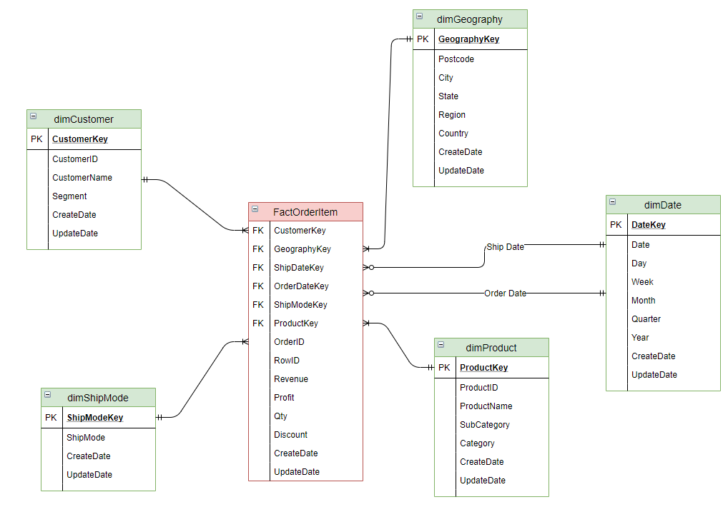
Base Star Schema
Notes:
Base schema as normal

Slide 7
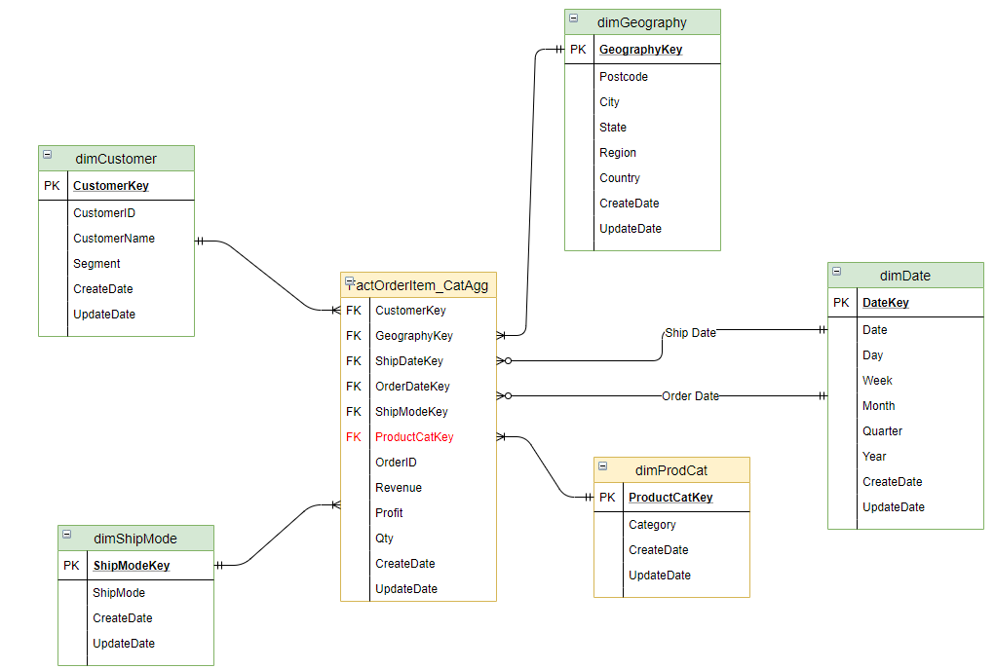
New aggregated fact table with columns removed that are no longer applicable at the level of ProductCategory
RowID
Discount
Does not link to dimProduct. Links to dimProdCat via new foreign key ProductCatKey
Aggregated Fact and Dimension Table
New dimProdCat table to hold just the category. Needs new surrogate key which is also the foreign key in the summarised fact table

Slide 8
Many aggregate fact and dimension tables can be created in an enterprise data warehouse in order to guarantee fast response times.
The BI layer of the data warehouse needs to keep track of which aggregate tables are available in order to select the correct aggregate for the query.
A layer of software between the end user application and the DBMS – the Aggregate Navigator interprets the end user’s query request and transforms it to use the best available aggregates.
Data warehouse analysts don’t typically get involved in building aggregates manually, rather they are configured using Aggregate Designers built into BI software.
Managing Aggregates

Slide 9
Summarised Tables
Another mechanism that data warehouses use to further speed up query performance is to have a set of summarised tables or views.
These tables are a subset of the data from the underlying Star Schema, which have dimension columns and facts pre-aggregated.
Any number of summary tables can be created depending on query requirements.
These tables are standalone tables rather than joined to facts and dimensions which we saw previously.

Slide 10
Summary Table Example
Total Revenue and Total Units Sold
by Product Sub Category, Region and Month
Notes:
Walk through this example on the board

Slide 11
A set of data organised and structured in a hierarchical, multi-dimensional arrangement.
Derived from the facts and dimensions that make up the Star Schema but can also use data from summary tables and aggregates.
The structure of the cube is itself, a Star Schema with facts and dimensions they are just subsets of the underlying Star Schema.
They won’t contain all the dimensions – just the dimensions of interest to a particular domain area (e.g., Sales).
Will contain dimension columns that exist in hierarchies to enable drilldown and rollup (e.g., Country > Region > State > City).
The fact columns are typically aggregated to a higher level than the base star depending on query requirement (e.g., Total Sales by Week rather than by Day).
Many OLAP cubes are typically created.
They are made available to the BI layer of the data warehouse and users will interact with them directly for querying.
OLAP Cubes

Slide 12
Case Study Task: Part 6 – Creating Summary Tables

